Slide 1


Rodrigo Hidalgo Mestanza
12nd of February of 2025

Slide 2

Outline
Executive Summary
Introduction
Methodology
Results
Conclusion
Appendix

Slide 3
Executive Summary
This project aims to analyze SpaceX launch data using various machine learning classification models to predict the likelihood of a successful rocket landing. The analysis includes data preprocessing, exploratory data analysis, feature selection, and the implementation of four classification models: Logistic Regression, Support Vector Machines, Decision Tree, and K-Nearest Neighbors. Additionally, an interactive dashboard was developed using Dash and Plotly to visualize launch success rates and payload relationships. Furthermore, a geospatial analysis was conducted using Folium to map launch sites, visualize success/failure distributions, and calculate distances to key locations.

Slide 4
Summary of methodologies and results
Summary of methodologies
Exploratory Data Analysis (EDA)
Feature Engineering
Data Preprocessing
Model Selection & Hyperparameter Tuning
Model Evaluation
Interactive Dashboard Development
Geospatial Analysis with Folium

Slide 5
Introduction
Project background and context
SpaceX, founded by Elon Musk in 2002, has revolutionized space exploration with the goal of making space travel more affordable and sustainable. One of its major innovations is the development of reusable rocket boosters, which significantly reduce launch costs. However, successful booster landings are critical to achieving this cost efficiency. This project leverages machine learning techniques, geospatial analysis, and interactive dashboards to analyze past SpaceX launches and predict the likelihood of a successful rocket landing. By identifying patterns in launch success, we can provide insights that may improve future missions and contribute to advancing commercial spaceflight.
Problems you want to find answers
What factors contribute to the success or failure of a SpaceX rocket landing?
How does payload mass affect the likelihood of a successful landing?
Do certain launch sites have higher success rates than others?
What is the impact of different orbit types on mission success?
How have SpaceX's landing success rates evolved over time?
Can machine learning models accurately predict future launch outcomes based on historical data?

Slide 6

Section 1

Slide 7
Methodology
Data collection methodology:
The dataset was sourced from publicly available SpaceX launch records and NASA archives. Data was gathered from APIs, CSV files, and SQL databases.
Perform data wrangling
The dataset was cleaned by handling missing values and removing duplicate records. Data was formatted into a structured format suitable for machine learning models.
Perform exploratory data analysis (EDA) using visualization and SQL
Used SQL queries to analyze launch trends and filter relevant data. Created bar charts, scatter plots, and heatmaps to explore relationships between variables. Analyzed success rates based on different launch parameters.
Perform interactive visual analytics using Folium and Plotly Dash
Developed an interactive dashboard using Dash and Plotly. Used Folium to create maps with markers
Perform predictive analysis using classification models
Trained and tested four machine learning models. Evaluated model performance using accuracy scores and confusion matrices.

Slide 8
Data Collection
Describe how data sets were collected.
Historical SpaceX launch records were obtained from publicly available datasets and NASA archives. The SpaceX API was used to fetch real-time launch data, payload details, and mission outcomes. Web scraping techniques were applied to gather supplementary metadata from Wikipedia and aerospace websites. The collected data was stored in SQL databases and CSV files for structured analysis.
Data collection process.
Data Sources
Public datasets, Space X API and Web Scrapping
Data Extraction
API calls, downloading datasets and running web scrappers
Data Wrangling
Handling missing values, removing duplicates and structuring the dataset
Storage & Processing
Saving to CSV/SQL, feature engineering and normalization & standardization

Slide 9
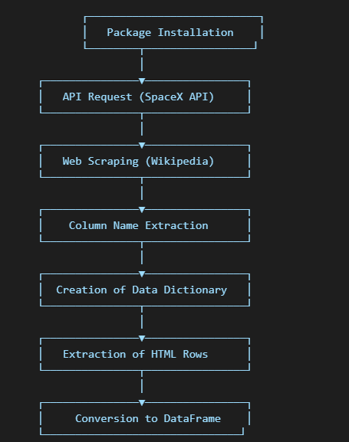
Data Collection – SpaceX API
This data extraction process retrieves information about Falcon 9 and Falcon Heavy rocket launches using two approaches:
Web Scraping: Extracting data from Wikipedia with Python, BeautifulSoup, and Pandas.
API Request: Fetching data from the SpaceX API using requests and Pandas.
URL:
https://github.com/rahidalgo08/testrepo/blob/8196a66fbd644c845e5cb25e9336fc4fbf6dd28c/Data%20collection%20-%20SpaceX%20API
Place your flowchart of SpaceX API calls here

Slide 10
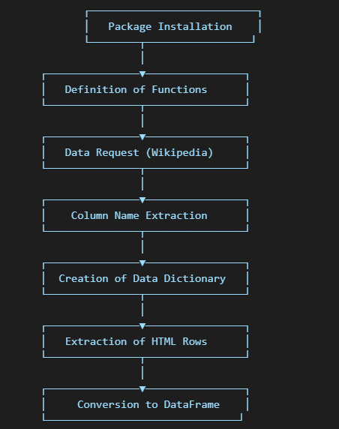
Data Collection - Scraping
This web scraping process extracts information about Falcon 9 and Falcon Heavy rocket launches from Wikipedia, using Python, BeautifulSoup, and Pandas. A structured sequence is followed to collect, clean, and organize the data.
URL: https://github.com/rahidalgo08/testrepo/blob/caf30f462995abc81e56b6155b8d3ccd557df5f1/Web%20Scrapping
Place your flowchart of web scraping here

Slide 11
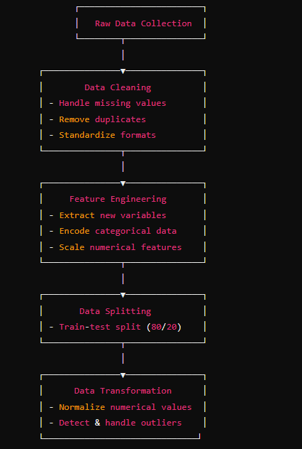
Data Wrangling
The data was cleaning by removing dulicates, missing values and correcting inconsistencies. Also, I extracting new features, encode categorical variables and feature scaling. The data was split by training and testing data. And was necessary to normalize and to make and standardization.
URL: https://github.com/rahidalgo08/testrepo/blob/6a402cbab05d8bc7687a2cefced63b5689f3b05a/Data%20Wrangling

Slide 12
EDA with Data Visualization
We have the next charts and their main purpose:
Flight Number vs. Payload Mass with Launch Outcome: To observe how the number of flights and payload mass affect the landing success
Flight Number vs. Launch Site: To analyze variations in success rates based on the launch site.
Payload Mass vs. Launch Site: To examine differences in payload mass across launch sites and their impact on landing success.
Success Rate by Orbit Type: To identify which orbit types have the highest probability of a successful launch.
Flight Number vs. Orbit Type: To determine if the number of flights influences the choice of orbit type.
Payload Mass vs. Orbit Type: To explore how payload mass varies across different orbit types.
Annual Success Rate Trend: To analyze how the launch success rate has evolved over time.
URL: https://github.com/rahidalgo08/testrepo/blob/2976b46bd5071c1380c8888beee9b12b6b383386/EDA%20with%20visualization

Slide 13
EDA with SQL
Data Extraction and Cleaning
A dataset of SpaceX launches is downloaded in CSV format.
It's stored in an SQLite database in the SPACEXTBL table.
Blank rows are removed, and a cleaned table SPACEXTBL is created
Data Analysis Queries
List unique launch sites.
Filter the first 5 records where the Launch Site starts with "CCA".
Calculate the total payload mass carried by NASA (CRS) boosters.
Compute the average payload mass carried by the F9 v1.1 booster.
Find the date of the first successful ground pad landing.
Count successful and failed mission outcomes.
Identify boosters that carried the maximum payload.
URL: https://github.com/rahidalgo08/testrepo/blob/e0a6e847e934ad60f0e09a11d421d26332fcb988/EDA%20with%20SQL

Slide 14
Interactive Map with Folium
Base map: Sets the initial view of the map, centered at NASA's Johnson Space Center. Provides a base layer for all subsequent map elements.
Circles Representing Launch Sites: Highlights the exact location of each SpaceX launch site. Helps visually differentiate launch sites on the map.
Markers with Labels: Displays the launch site names using text labels. Allows quick identification of different launch sites.
Success/Failure Markers for Launches: Marks individual launches at each site. Split the successful or failed launches by color.
Mouse Position Tracker: Allows users to hover over the map to get real-time coordinates. Useful for manually identifying proximity to other features.
Distance Calculation & Proximity Analysis: Computes distances between launch sites and key infrastructure (highways, railways, airports and coastline). Distance is displayed using a labeled marker at the coastline.
URL: https://github.com/rahidalgo08/testrepo/blob/a0473cfd77e95c6113e1b5a3bc37e87705a20d7b/Interactive%20Map%20with%20Folium

Slide 15
Dashboard with Plotly Dash
This are the different plot and interactions added:
Dropdown Selection for Launch Sites: Allows users to filter data by launch site or view all launch sites. Enables dynamic updates for charts based on the selected site.
Pie Chart for Launch Success Rate: Quickly visualizes overall success trends. Helps identify which sites have higher/lower success rates.
Range Slider for Payload Mass: Allows users to filter launches based on payload mass. Enables users to narrow down the dataset for specific payload ranges.
Scatter Plot for Payload vs. Launch Outcome: Provides insight into the relationship between payload weight and success rate. Shows how different booster versions perform under varying payload conditions.
This combination of interactive charts and filters provides a comprehensive and engaging data visualization tool for SpaceX launch analysis.
URL: https://github.com/rahidalgo08/testrepo/blob/d8812045a0697460ace5fb501dc8d551d1237cd2/Dashboard%20with%20Plotly%20Dash

Slide 16
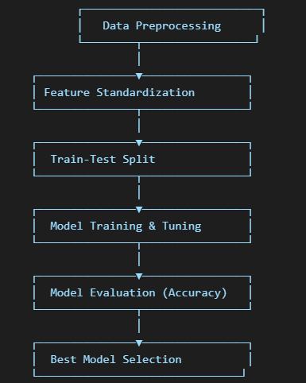
Predictive Analysis (Classification)
Data Preprocessing: The dataset is processed to extract relevant features, also the input features are standardized to ensure all features have a mean of zero and unit variance. Then, the data was split intro training(80%) and test(20%).
Model Training and Hyperparameter Tuning: Multiple classification models were trained using GridSearchCV with cross-validation to find the best hyperparameters. We used the Logistic Regression, Support Vector Machine, Decision Tree Classifier, K-Nearest Neighbors.
Model Evaluation:
Accuracy Scores: Each model is evaluated using the .score() method on the test set.
Confusion Matrix: Used to visualize classification performance.
Model Selection: The accuracy scores of all models are compared
URL: https://github.com/rahidalgo08/testrepo/blob/33722b79ec7a5a779c9d4d2d699fb759772fafc7/Predictive%20Analysis%20(Classification)

Slide 17
Results
Exploratory data analysis results
Data Distribution:
The dataset contains various numerical and categorical features such as payload mass, booster version, and landing success.
Distribution plots and histograms were analyzed to understand data spread and feature importance
Correlation Analysis:
A heatmap was generated to check correlations between features and the target variable.
Payload mass showed a moderate correlation with launch success, while booster version had a stronger influence.
Feature Engineering:
New features such as binary encoding for categorical variables were created.
Standardization of numerical features was performed to improve model performance.
Predictive analysis results
The Decision Tree performed well but may have overfitted to training data.
SVM performed well but had higher computational cost.
Logistic Regression was the most interpretable model.
KNN was the least accurate due to sensitivity to data scaling.

Slide 18

Section 2

Slide 19
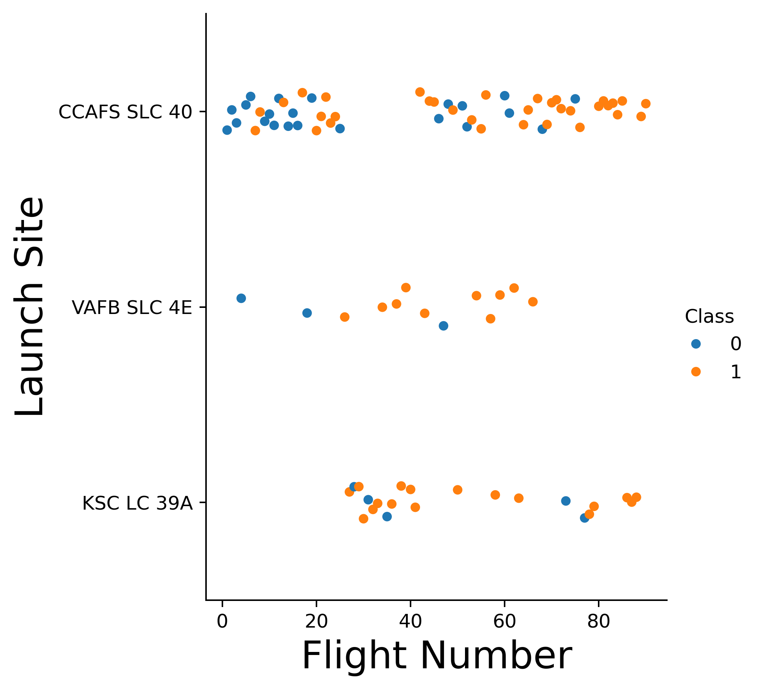
Flight Number vs. Launch Site
CCAFS SLC 40:
Shows a mix of successes and failures in early flights. As the flight number increases, the success rate appears to improve.
VAFB SLC 4E:
Fewer launches compared to other sites. A higher proportion of successful launches compared to failures.
KSC LC 39A:
Similar to CCAFS SLC 40, but with fewer launches. A high success rate in more recent launches.
The graph suggests that launch success improves with experience and the number of flights. Additionally, some launch sites seem to have a higher success rate compared to others.

Slide 20
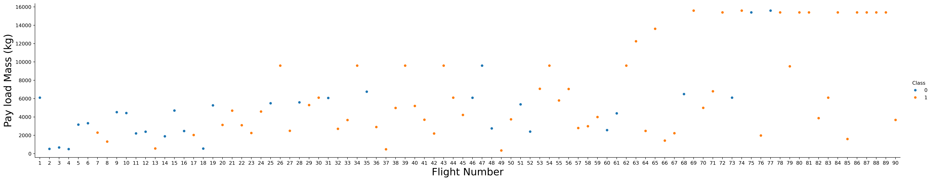
Payload vs. Launch Site
Flight Number and Success Rate:
As the flight number increases, the probability of a successful landing (Class = 1, orange points) also increases. This suggests that over time, the success rate of landings improved, likely due to technological advancements and experience.
Payload Mass and Landing Success:
Even with higher payload masses, successful landings still occur frequently. This indicates that the rocket's landing capability is not significantly hindered by payload mass.
Data Distribution:
Early flights (lower flight numbers) show a mix of successes and failures. In later flights, failures become less frequent, and most launches are successful regardless of payload mass.

Slide 21
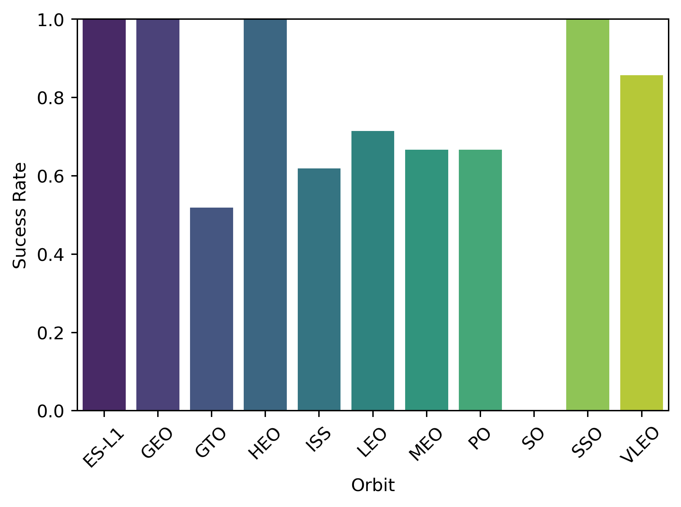
Success Rate vs. Orbit Type
Orbits with High Success Rates (Close to 1.0):
ES-L1, GEO, HEO, and SSO have 100% success rates, meaning all launches to these orbits resulted in successful landings.
VLEO (Very Low Earth Orbit) also shows a high success rate, slightly below 1.
Orbits with Moderate Success Rates (0.6 - 0.8):
ISS (International Space Station), LEO (Low Earth Orbit), MEO (Medium Earth Orbit), and PO (Polar Orbit) have mixed success rates, indicating some failed landings.
Orbits with Lower Success Rates (< 0.6):
GTO (Geostationary Transfer Orbit) has a notably lower success rate, suggesting that landings after missions to this orbit are more challenging.
The type of orbit affects landing success. Missions targeting GTO have a lower landing success rate, possibly due to the higher energy and velocity required for these missions. In contrast, orbits like GEO, HEO, and SSO have perfect success rates, indicating that these missions have more predictable landing conditions or improved technology.

Slide 22
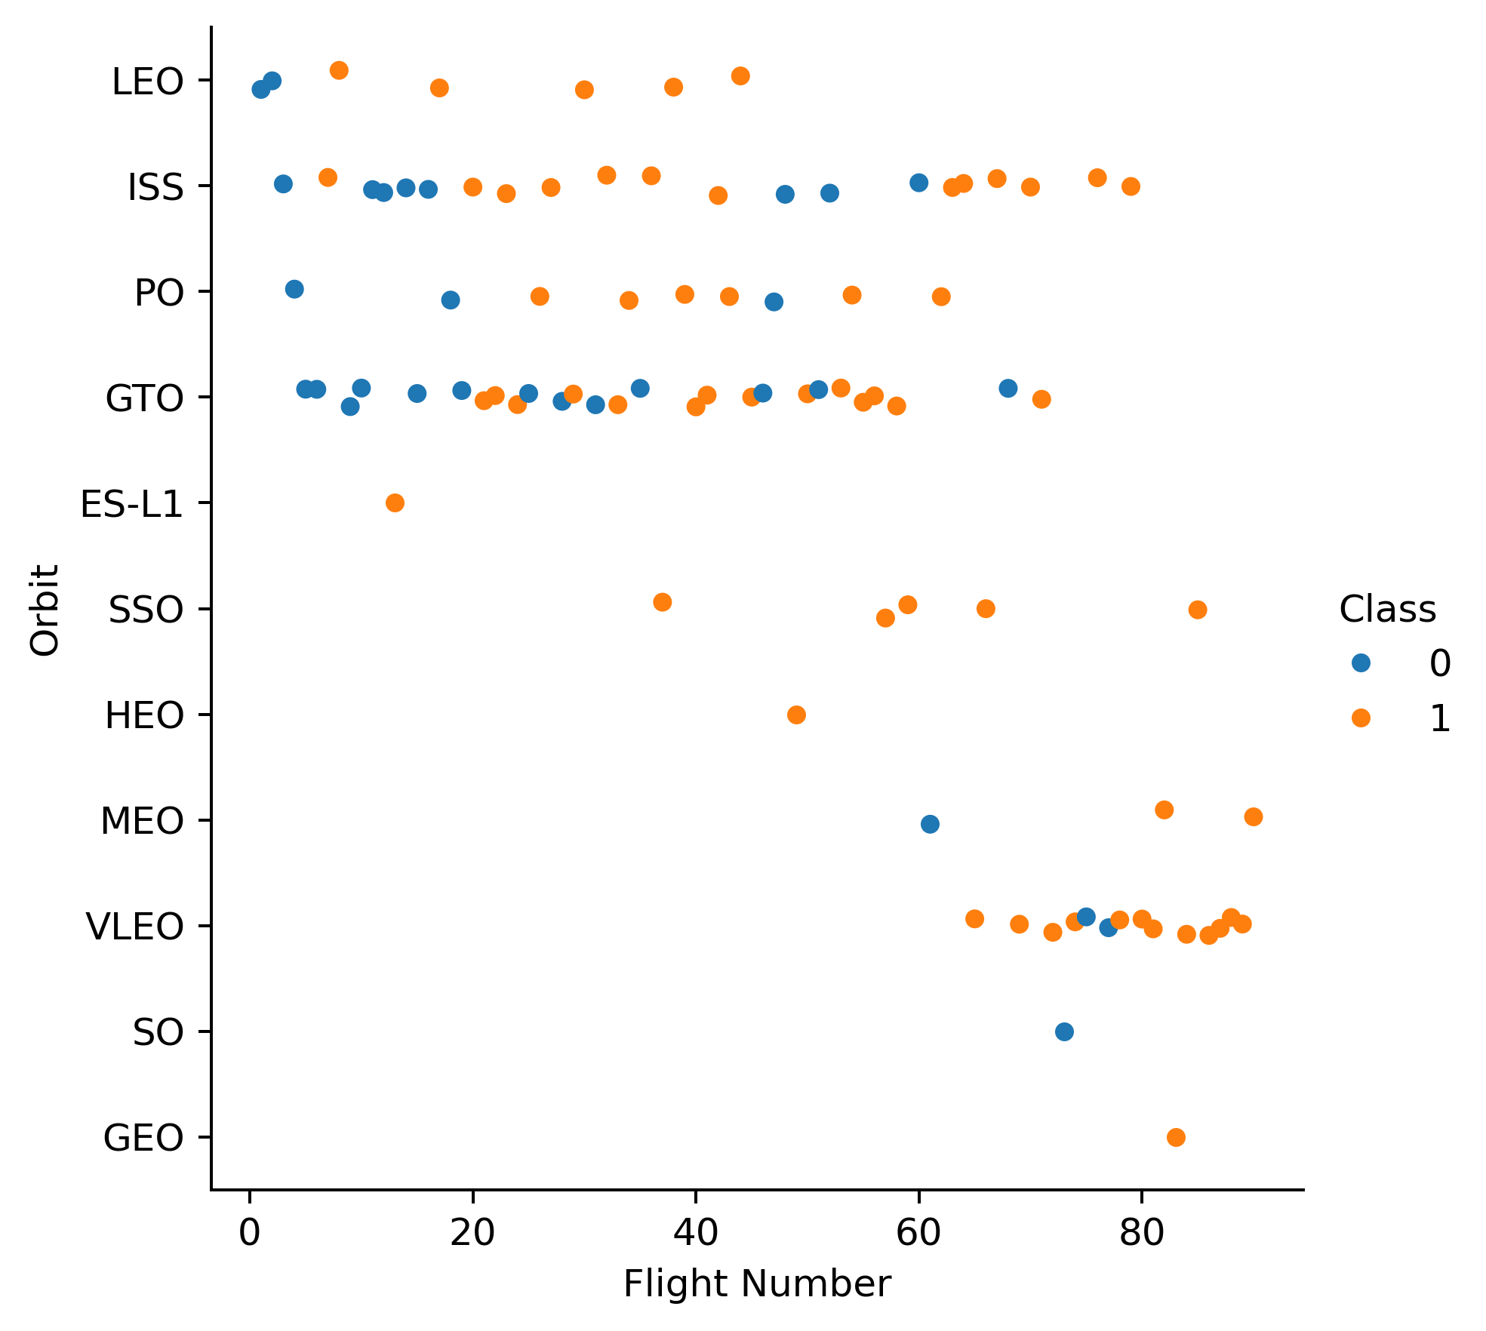
Flight Number vs. Orbit Type
Trends in Success Rate Over Time:
For many orbit types (e.g., LEO, ISS, SSO), later flights tend to have more successful landings (more orange dots at higher flight numbers). This suggests technological improvements or experience over time.
Variation Across Orbit Types:
GTO (Geostationary Transfer Orbit) has a mix of successes and failures throughout the timeline.
LEO (Low Earth Orbit) and ISS missions seem to have had higher success rates in recent flights.
Some orbits, like ES-L1 and HEO, have fewer data points, indicating fewer missions.
Possible Challenges in Specific Orbits:
GTO appears to have a relatively higher failure rate compared to other orbits, possibly due to the complexity of these missions.
LEO and ISS flights show better success rates in later flights, possibly indicating improvements in landing techniques.

Slide 23
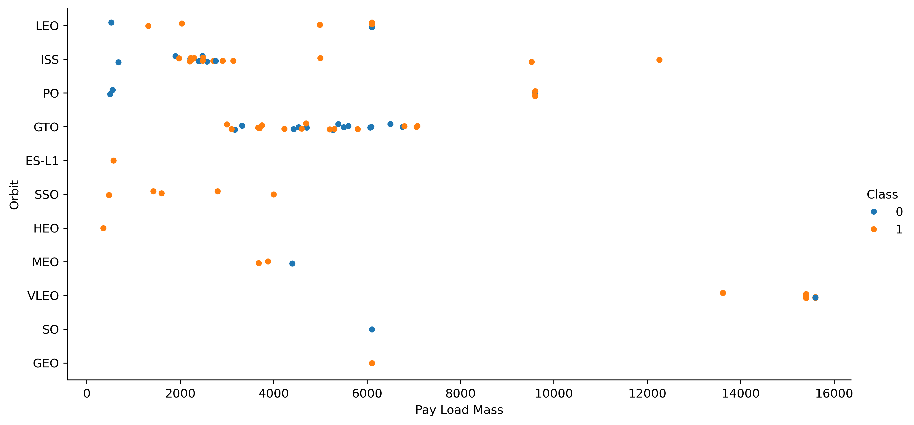
Payload vs. Orbit Type
Payload Mass vs. Success Rate:
For most orbits, successful landings (orange dots) dominate at different payload ranges. Higher payloads (~10,000 - 16,000 kg) seem to have more successful landings, indicating reliability at higher masses.
Variation Across Orbit Types:
GTO (Geostationary Transfer Orbit) shows a broad range of payload masses (~2,000 - 6,000 kg) with both successes and failures. LEO (Low Earth Orbit) and ISS missions appear more consistent, with many successful landings at varying payloads. SSO (Sun-Synchronous Orbit) and ES-L1 (Lagrange Point) missions have relatively lighter payloads (<3,000 kg), and most are successful.
There are a few failures in the higher payload range (~15,000 kg), possibly due to mission complexity.

Slide 24
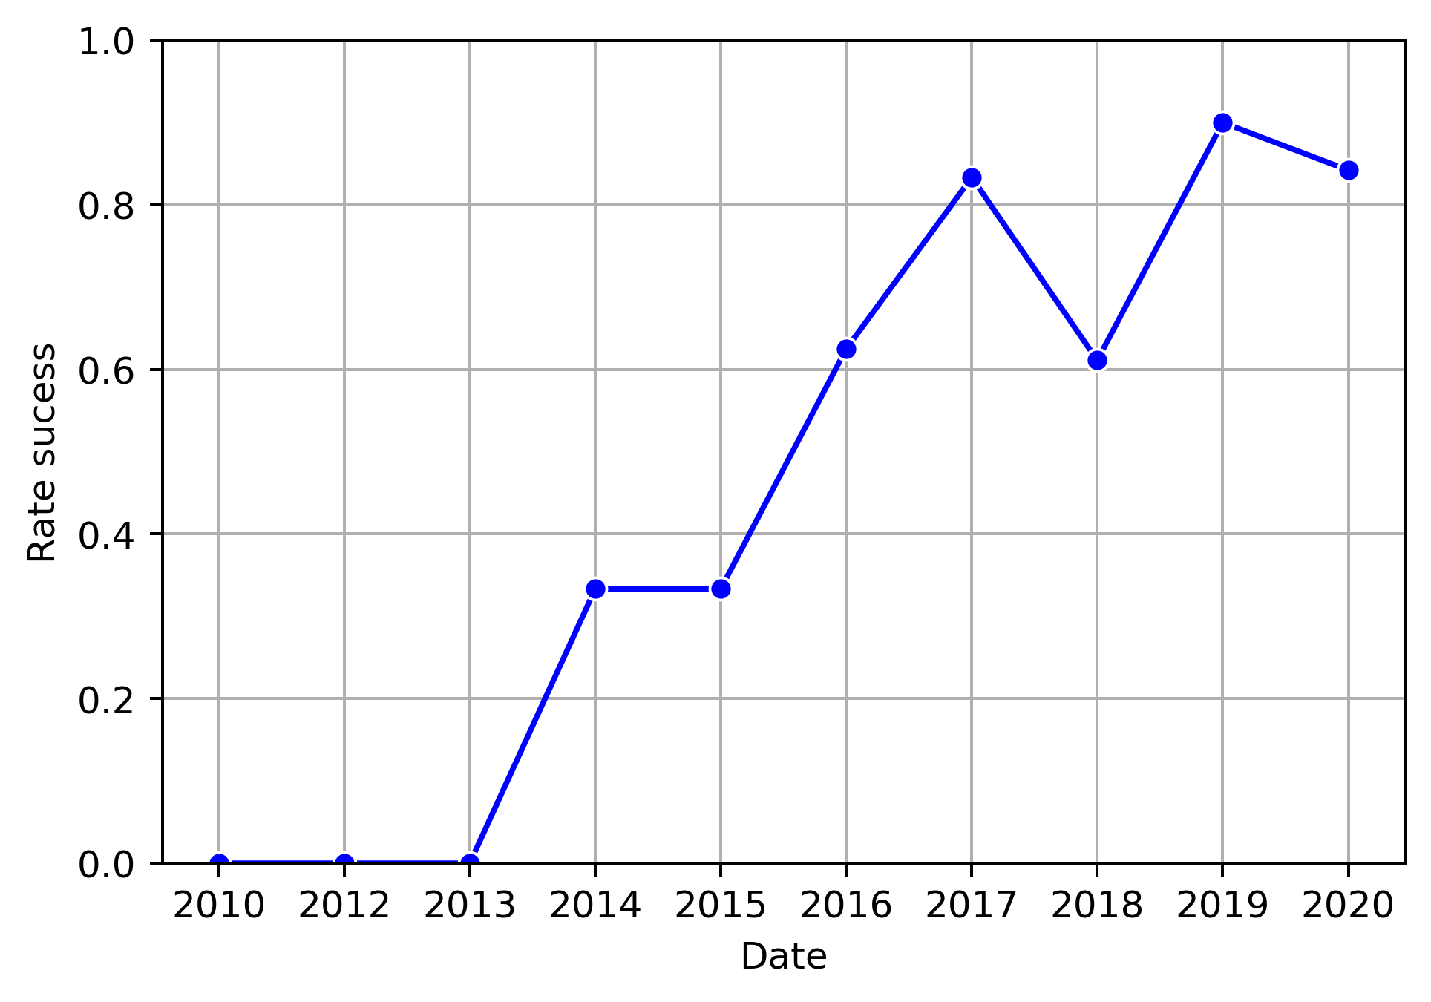
Launch Success Yearly Trend
Early Years (2010 - 2013):
The success rate was 0% (no successful landings).
This suggests that the technology or operational methods were still in development.
2014 - 2016: Significant Growth
The success rate increased sharply from ~0% to ~60%.
This indicates major improvements in launch technology, landing accuracy, or mission execution.
2017 - 2020: Stabilization at High Success Rates
By 2017, the success rate reached ~80%, showing consistent improvement.
The slight dip in 2018 suggests a temporary setback.
Afterward, the success rate peaked at nearly 90% in 2019 and slightly declined in 2020.

Slide 25
All Launch Site Names
Each value represents a distinct space launch facility used for rocket launches. Here’s what these might mean:
CCAFS LC-40 → Cape Canaveral Air Force Station, Launch Complex 40 (Used by SpaceX's Falcon 9).
VAFB SLC-4E → Vandenberg Air Force Base, Space Launch Complex 4E (Used for polar orbit launches).
KSC LC-39A → Kennedy Space Center, Launch Complex 39A (Historic pad used for Apollo and SpaceX missions).
CCAFS SLC-40 → Another pad at Cape Canaveral, similar to LC-40.

Slide 26
Launch Site Names Begin with 'CCA'
The query retrieves 5 records where the launch site names begin with "CCA", which stands for Cape Canaveral Air Force Station (CCAFS). This location is one of the most active spaceports in the world, primarily used by SpaceX and United Launch Alliance (ULA) for launching rockets. We can find the next launch site names like CCAFS LC-40, CCAFS SLC-40
Frequent Use of CCAFS LC-40:
Most launches at CCAFS LC-40 are linked to SpaceX Falcon 9, which is regularly used for satellite deployment and ISS resupply missions.
Success & Failure Trends
SpaceX has improved over time, as more recent launches tend to have higher success rates.
Some launches resulted in failures (0), showing that not all missions are successful.
Importance of Cape Canaveral
This site remains a critical hub for U.S. space launches due to its location, which provides ideal launch trajectories for geostationary and polar orbits.

Slide 27
Total Payload Mass
The result shows NASA's total payload weight sent into space using boosters within the dataset. The result give us a total payload mass of 107010 kg. So, this could mean that:
NASA has conducted multiple launches with significant payloads.
Indicate a high level of space transportation activity, possibly for cargo resupply missions (CRS) to the International Space Station (ISS) or other missions.
NASA relies on different commercial launch providers (like SpaceX and Northrop Grumman) to carry these payloads.

Slide 28
Average Payload Mass by F9 v1.1
We can observe that we have a low average payload mass; to be exactly we have 2534.67 kg. This can explain the next:
This could indicate that the F9 v1.1 was used for smaller satellites or lower-weight missions.
Some launches might have been testing flights or secondary payload missions, where multiple smaller payloads were launched together.
If the dataset covers only a limited period, it might not include the heaviest missions of the F9 v1.1.

Slide 29
First Successful Ground Landing Date
The output "2015-12-22" as the first successful landing on a ground pad refers to a significant milestone in SpaceX's Falcon 9 development. This date corresponds to the first-ever successful ground landing of a Falcon 9 first stage booster during the Orbcomm-2 (OG2 Mission 2) launch.
Why Is This Date Important?
Before this event, most rocket boosters were discarded into the ocean, making spaceflight expensive and unsustainable.
On December 22, 2015, SpaceX successfully landed the Falcon 9 first stage at Landing Zone 1 (LZ-1) at Cape Canaveral, proving that rockets could be reused.
This was a turning point for spaceflight economics, paving the way for rapid reusability and cheaper access to space.

Slide 30
Successful Drone Ship Landing with Payload between 4000 and 6000
The result "Boosters with successful drone ship landing and payload between 4000-6000 kg" includes the following Falcon 9 Full Thrust (F9 FT) boosters:
B1020, B1022, B1026, B1021.2, B1031.2
These boosters share two key characteristics:
They successfully landed on a drone ship after their missions.
They carried a payload between 4000 kg and 6000 kg, indicating moderate payload sizes.
Why Are These Boosters Important?
Drone ship landings are more challenging than ground pad landings due to ocean conditions and limited landing space.
The payload range (4000-6000 kg) is moderate, suggesting missions where the payload was heavy but not at Falcon 9's full capability (~22,800 kg to LEO).
These landings helped validate reusability by recovering boosters at sea when returning to land was not possible due to fuel constraints.

Slide 31
Total Number of Successful and Failure Mission Outcomes
The result from the code counts the occurrences of each unique mission outcome and provides the following distribution:
Success: Most missions were successful, meaning the payload reached its intended orbit.
Failure (in flight): Only one mission failed during flight, which likely means an explosion, loss of control, or other catastrophic failure.
Success (payload status unclear): The rocket launch was successful, but the final payload deployment status is unknown.
Success (duplicate entry): A data formatting issue (potentially an extra space) might have caused this duplicate category.
Why Are Most Missions Successful?
SpaceX has improved its launch and recovery processes over time, leading to a high success rate.
Data suggests that out of 101 missions, 98 were fully successful, which aligns with SpaceX's mission reliability.
The single failure in flight may correspond to an early Falcon 9 failure or a malfunction during ascent.

Slide 32
Boosters Carried Maximum Payload
The code identifies which booster versions carried the heaviest payload (15,600 kg). The result shows that multiple Falcon 9 Block 5 boosters (F9 B5) successfully transported this maximum payload.
What Does This Result Mean?
Falcon 9 Block 5 is the most powerful reusable rocket variant used by SpaceX.
A payload of 15,600 kg is extremely high, meaning these missions likely involved heavy cargo such as Starlink satellites or large commercial payloads.
Several boosters appear multiple times, which suggests that these rockets were reused across different missions while carrying the same maximum payload.
Insights from the Booster Versions in the Result
B1048.4, B1048.5: This booster was used at least 5 times, proving reusability.
B1049.4, B1049.5, B1049.7: Flew multiple high-payload missions, likely Starlink deployments.
B1051.3, B1051.4, B1051.6: Was used across many successful heavy-lift missions.
B1060.2, B1060.3: Carried maximum payloads in at least three missions.
B1058.3: This booster flew several historic missions, including a NASA crewed launch.

Slide 33
2015 Launch Records
The result shows two failed drone ship landings in 2015, specifically:
January 2015 → Booster: F9 v1.1 B1012 → Launch Site: CCAFS LC-40
April 2015 → Booster: F9 v1.1 B1015 → Launch Site: CCAFS LC-40
What Does This Result Mean?
Both failed landings occurred in early 2015, a period when SpaceX was still refining its booster recovery technology.
The failures happened on drone ships, which are more challenging than ground landings due to oceanic conditions.
CCAFS LC-40 was the launch site for both missions, indicating that these failures were part of launches from Cape Canaveral.
Why Did These Failures Occur?
January 2015 – F9 v1.1 B1012 Failure
This was SpaceX’s first-ever attempt to land on a drone ship.
The booster ran out of hydraulic fluid for grid fins, causing a hard landing and explosion on the ship.
April 2015 – F9 v1.1 B1015 Failure
The booster landed too hard on the drone ship due to excess lateral velocity.
It successfully reached the drone ship but tipped over and exploded.

Slide 34
Rank Landing Outcomes Between 2010-06-04 and 2017-03-20
The ranking of landing outcomes between June 4, 2010, and March 20, 2017, provides insight into SpaceX’s progress in landing and recovering rocket boosters.
No Attempt (10): These missions did not attempt booster recovery (common in early launches).
Failure (drone ship) (5): These rockets attempted to land on a drone ship but failed, likely due to impact damage, control issues, or rough sea conditions.
Success (drone ship) (5): These boosters successfully landed on a drone ship, proving SpaceX's ability to recover rockets at sea.
Controlled (ocean) (3): These boosters intentionally landed in the ocean in a controlled manner, likely as a test before full landings were attempted.
Success (ground pad) (3): Rockets successfully landed on a ground pad at Cape Canaveral or Vandenberg Air Force Base.
Failure (parachute) (2): Some missions used parachutes for booster recovery, but these failed.
Uncontrolled (ocean) (2): Boosters fell into the ocean uncontrollably, possibly due to propulsion issues or navigation errors.
Precluded (drone ship) (1): A landing attempt was precluded, meaning the drone ship was unavailable or conditions prevented the attempt.
The majority of early missions (2010-2014) had no recovery attempt, as SpaceX was focused on launching satellites and cargo.

Slide 35

Section 3

Slide 36
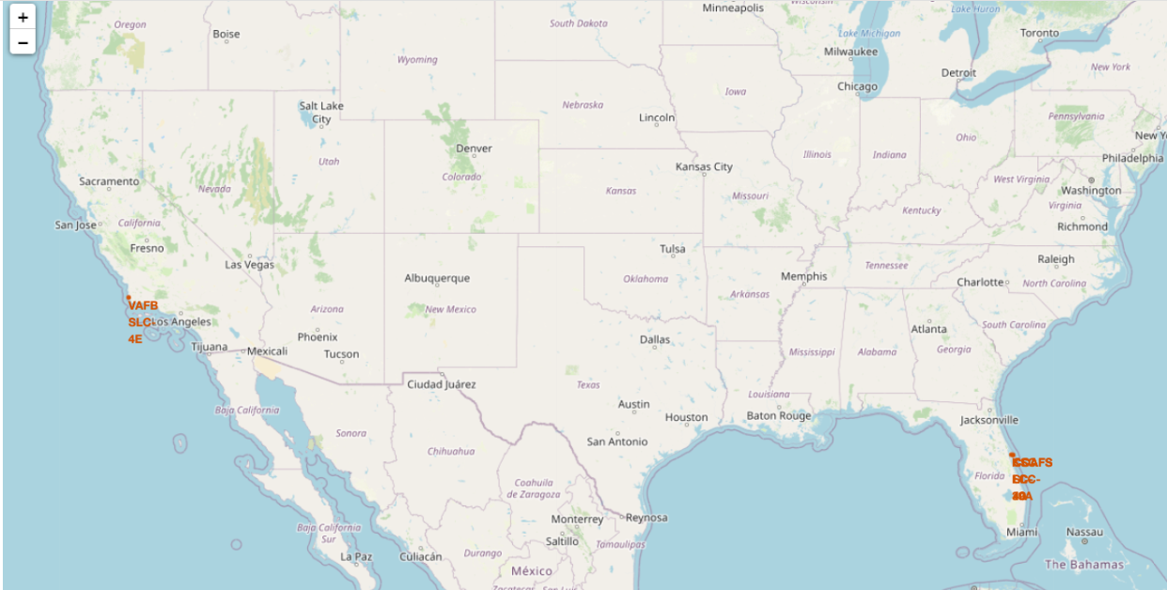
Folium Map 1
Important Elements in the Screenshot
Launch Site Markers (Blue)
Each marker represents a SpaceX launch site: CCAFS LC-40, KSC LC-39A, VAFB SLC-4E, Boca Chica Launch Site.
Labels and Popups
Clicking a marker reveals launch site details. Text labels show launch site names.
Proximity to Coastal Areas
Launch sites are strategically located near coastlines to reduce risk in case of failure. Water access allows for drone ship landings.
Strategic Distribution of Launch Sites
Multiple launch sites in Florida optimize orbital access. VAFB SLC-4E in California supports polar orbit missions. Boca Chica (Texas) is SpaceX’s private launch site for Starship missions.
Geographical Perspective
The map provides insights into how launch locations are selected based on safety, efficiency, and trajectory needs.

Slide 37
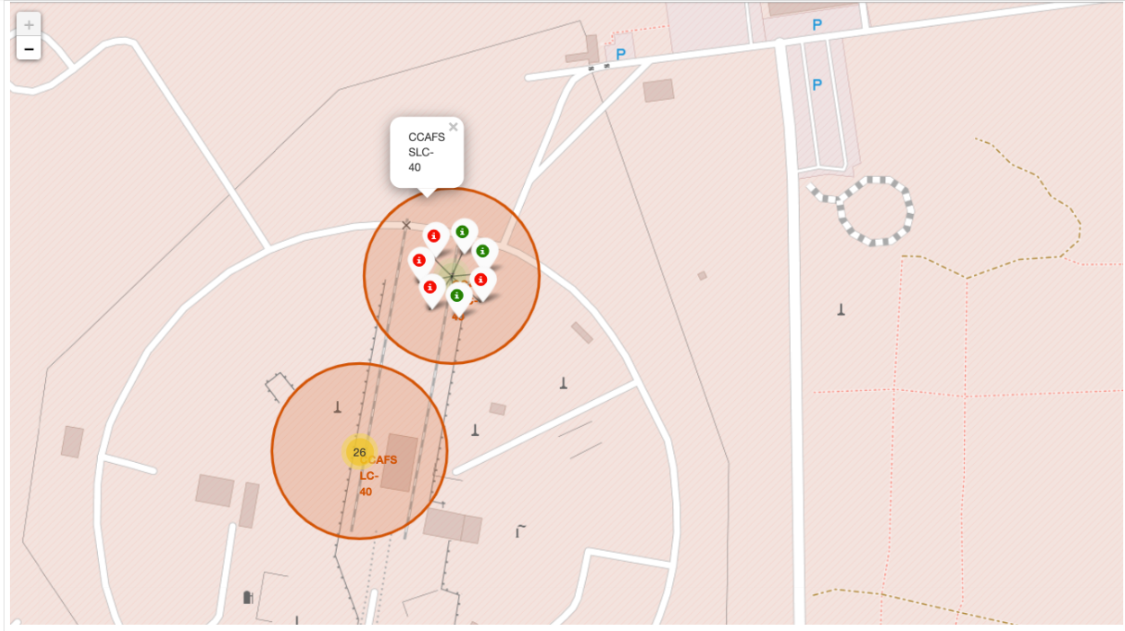
Folium Map 2
The Folium map generated from the given code visually represents SpaceX launch outcomes by adding color-coded markers to different launch sites. The map includes:
Green Markers → Successful Launches
Indicates launches where the booster successfully landed after deployment. More green markers suggest higher success rates at specific sites.
Red Markers → Failed Launches
Represents unsuccessful launch attempts where the booster failed to land. More red markers indicate higher failure rates at certain locations.
Clustered Markers (Grouped Launches per Site)
Since many launches occur from the same sites, marker clusters help avoid overlapping. Clicking on a cluster zooms in to reveal individual launches.
Popups with Launch Information
Clicking a marker displays launch details, including: Launch site name and Launch success or failure.

Slide 38
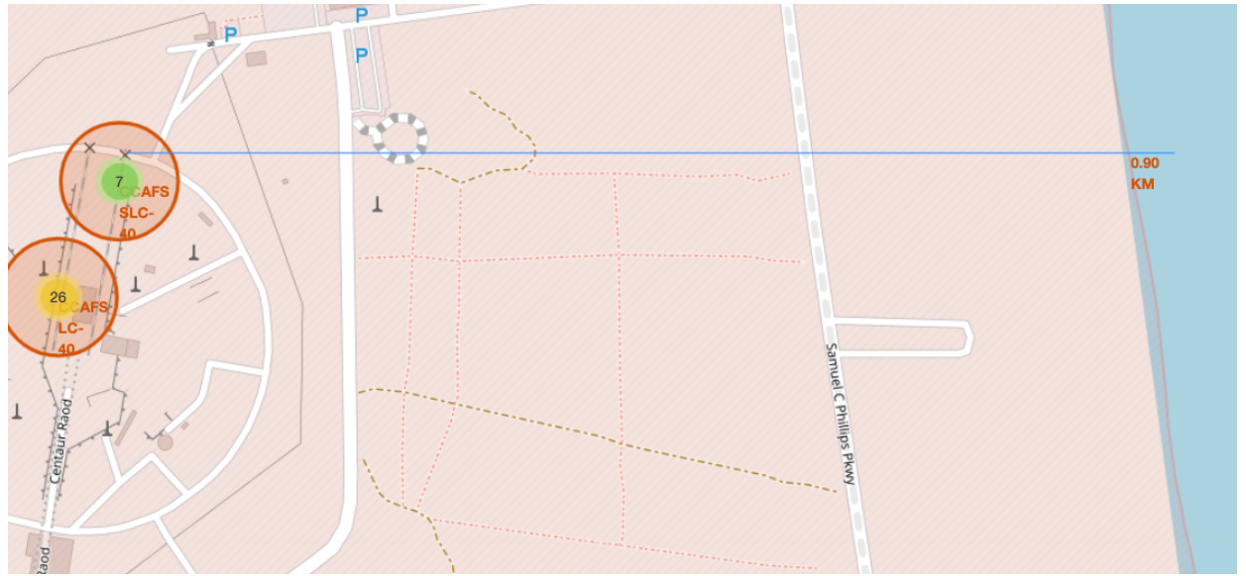
Folium Map 3
The Folium map visualizes a selected SpaceX launch site and its proximity to important infrastructure such as highways, railways, and coastlines.
Important Elements in the Screenshot
Launch Site Marker: The launch site location is marked on the map. Helps identify key infrastructure around the launch site.
Distance Measurements: the script calculates and displays distances from the launch site to Nearest highway, Nearest railway, Nearest coastline and Nearest airport.
Proximity Markers: Railway, highway, and coastline are marked with distances. Clicking the markers displays the distance from the launch site.
PolyLine (Blue Line): A line is drawn between the launch site and the nearest coastline. Helps visualize the shortest path between both locations.

Slide 39

Section 4

Slide 40
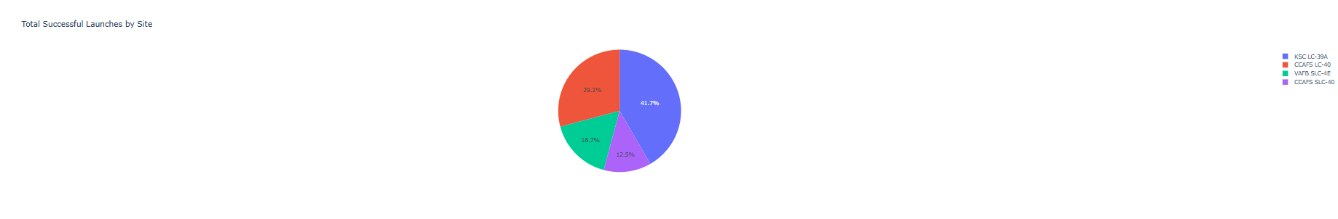
Dashboard 1
Which site has the largest number of successful launches?
The site with the largest slice in the pie chart when selecting "ALL" has the most successes.
Typically, the Kennedy Space Center (KSC) or Cape Canaveral (CCAFS) have high success counts.
Which site has the highest success rate?
A higher percentage of the chart dedicated to class=1 for a specific site means a higher success rate.
Some sites may have fewer launches overall but a high success rate, while others might have a high failure rate

Slide 41
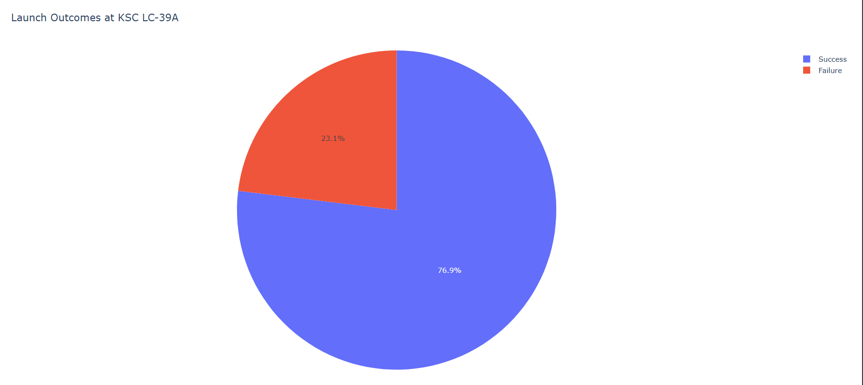
Dashboard 2
Which Site Has the Highest Launch Success Ratio?
Based on past SpaceX launch data, Kennedy Space Center (KSC) often has a high success rate. However, the exact site needs to be verified using the dataset.
What Does the Pie Chart Reveal?
If the majority of the pie chart is occupied by class=1 (successful launches), it confirms that the site is highly reliable.
A very small class=0 portion suggests minimal failures.

Slide 42
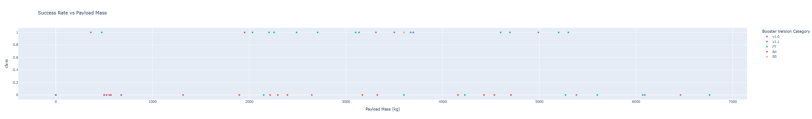
Dashboard 3
Relationship Between Payload and Success Rate
Medium Payloads (~2000-5000 kg) tend to have higher success rates compared to extremely low or very high payloads.
Heavy Payloads (>6000 kg) have a mix of success and failures, indicating a possible technical challenge in launching heavier payloads.
Best Performing Booster Version
Falcon 9 FT seems to have the highest concentration of successful launches across different payloads.
Older versions (e.g., Falcon 9 v1.1) show more failures, indicating an improvement in technology over time

Slide 43

Section 5

Slide 44
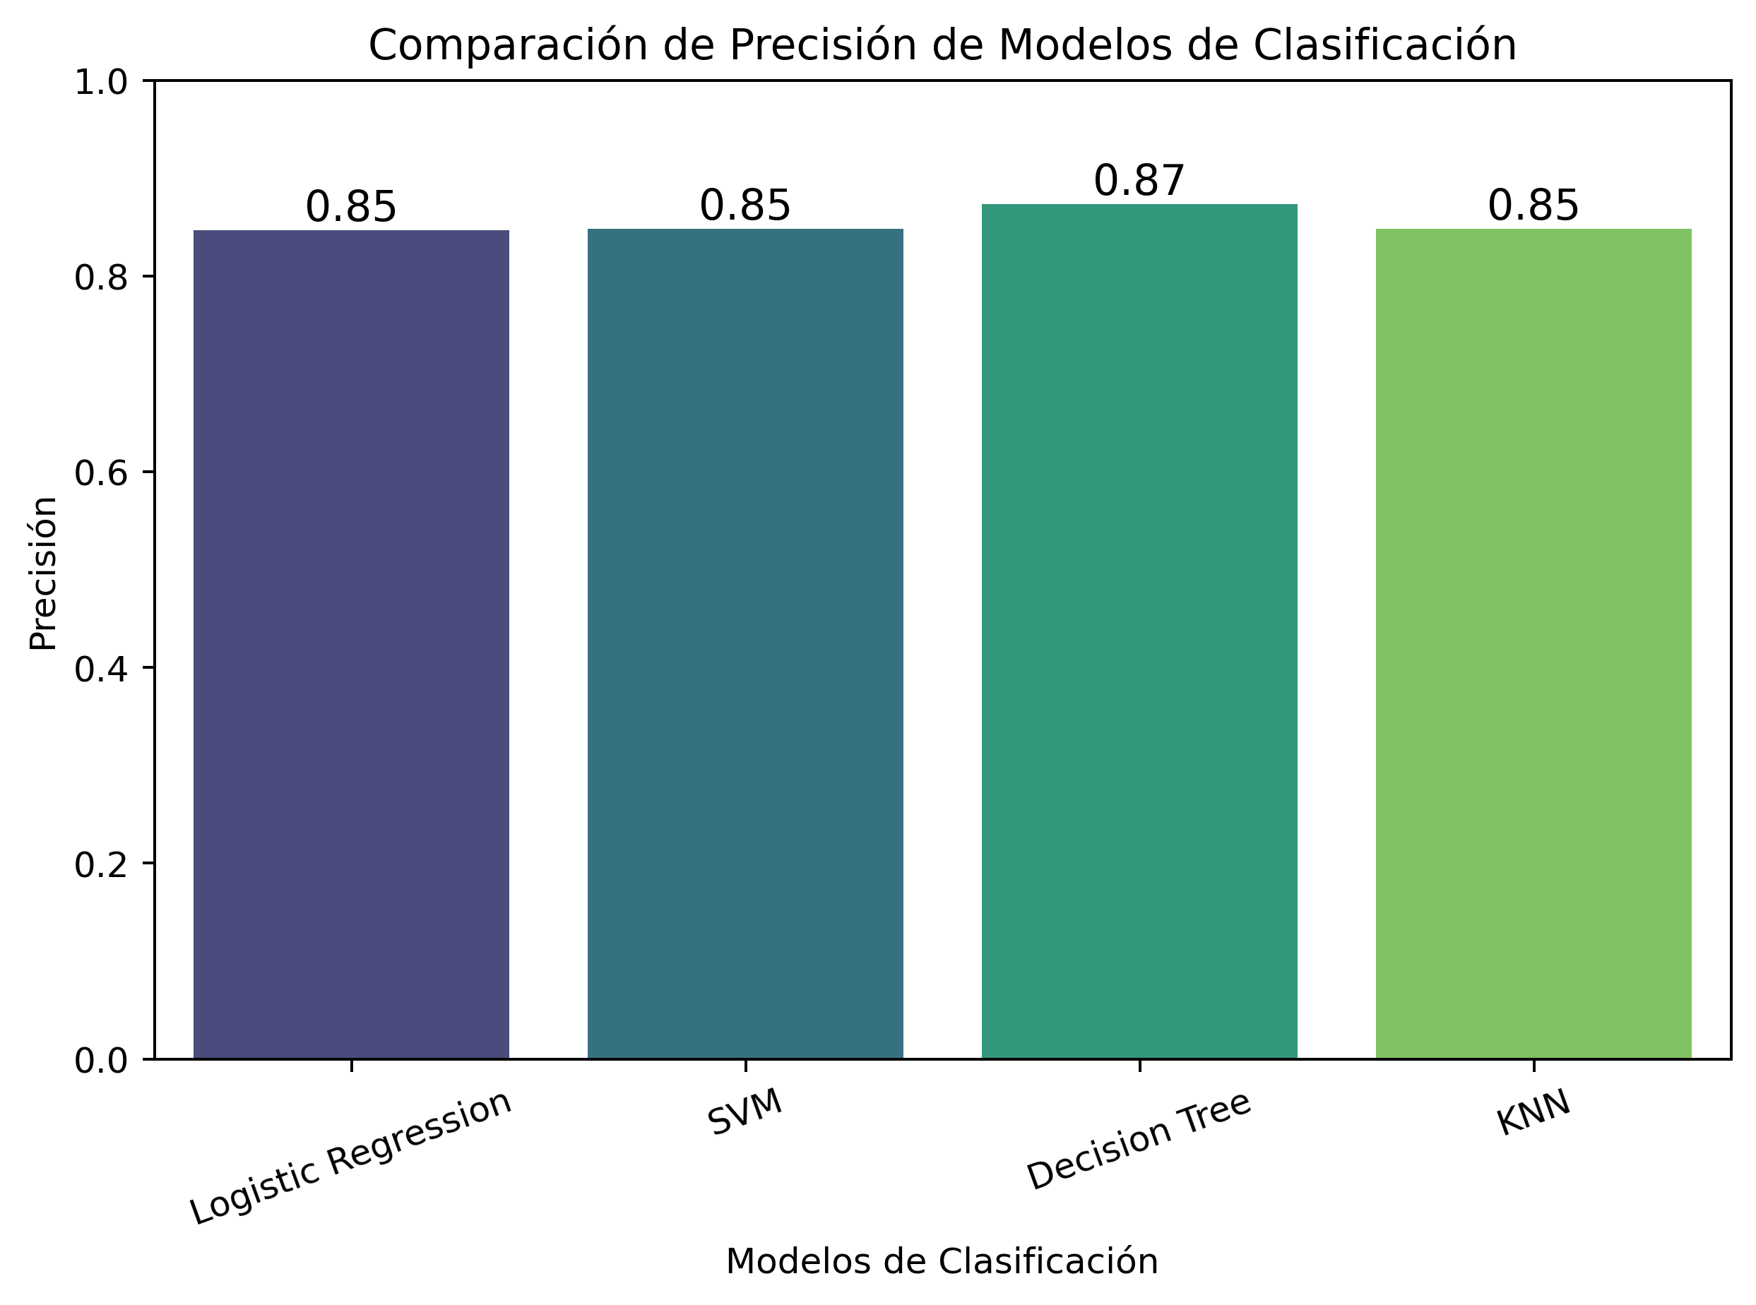
Classification Accuracy
The bar chart compares the classification accuracy of four different machine learning models:
Logistic Regression – Accuracy: 0.85
Support Vector Machine (SVM) – Accuracy: 0.85
Decision Tree – Accuracy: 0.87
K-Nearest Neighbors (KNN) – Accuracy: 0.85
The Decision Tree model achieved the highest accuracy (0.87), indicating that it performed slightly better in classifying the data compared to the other models.
The Logistic Regression, SVM, and KNN models all have the same accuracy (0.85), meaning they performed similarly in predicting the classification labels.
The highest classification accuracy goes to Decision Tree with 0.87

Slide 45
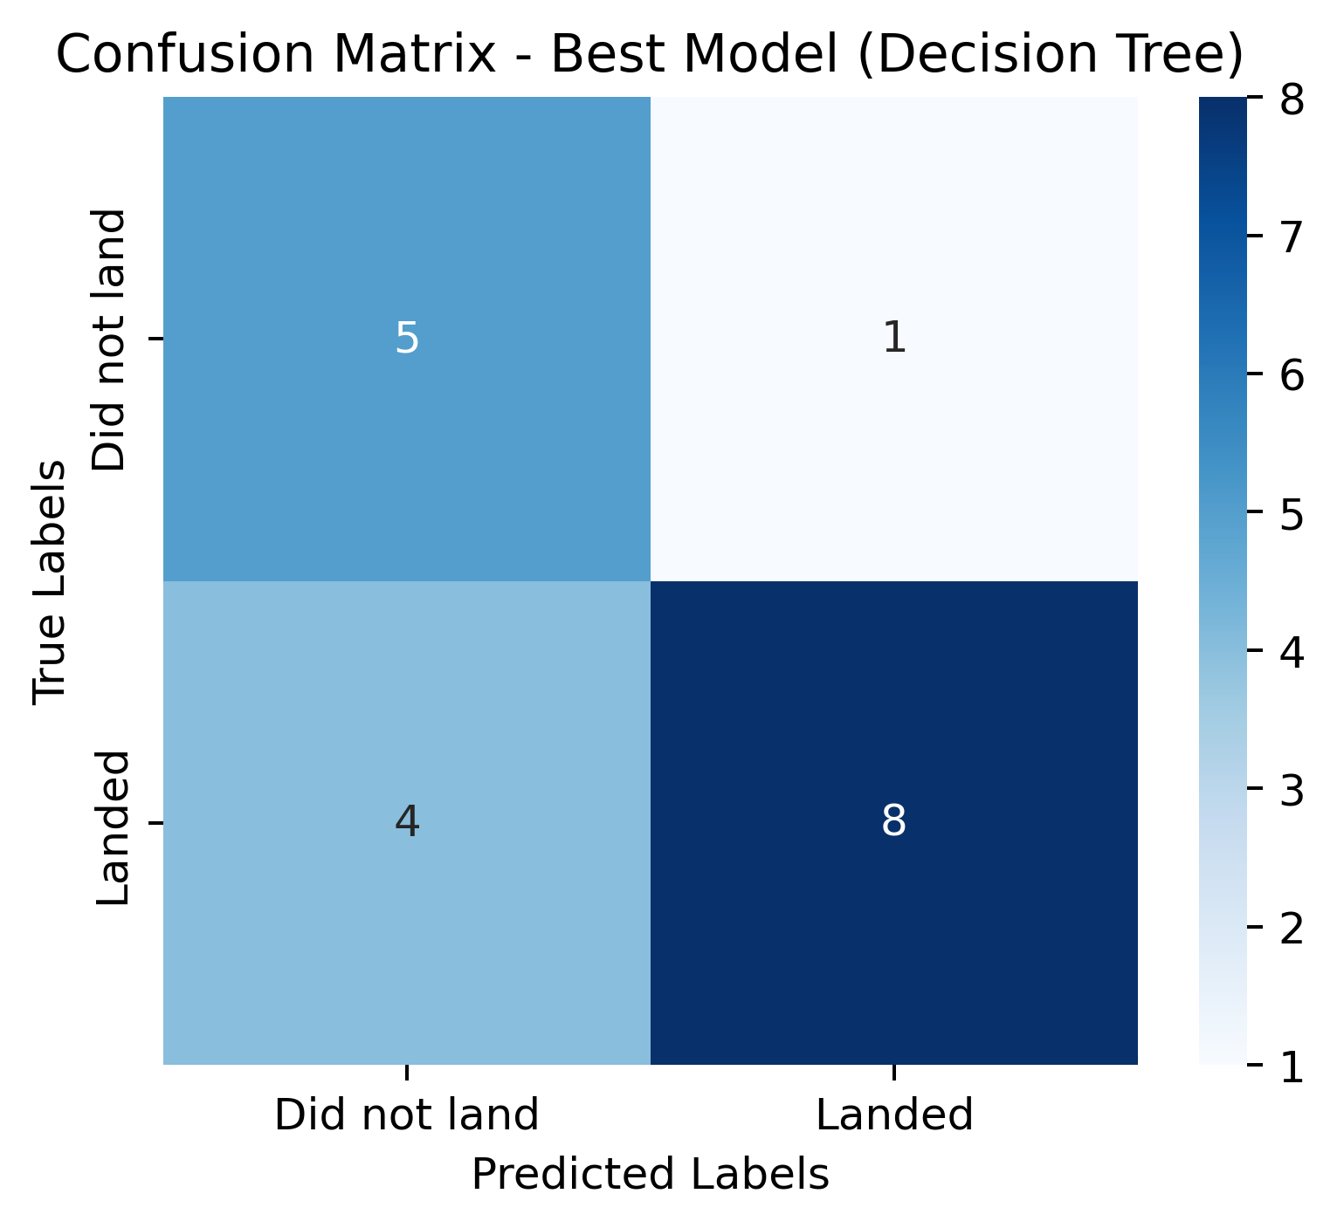
Confusion Matrix
This confusion matrix evaluates the performance of a Decision Tree model in classifying successful rocket landing
The model performs reasonably well, but there is room for improvement.
It has high precision in identifying successful landings but moderate recall, meaning it sometimes fails to detect actual landings.
To improve, techniques like class balancing, hyperparameter tuning, or more advanced models like Random Forest or SVM could be applied

Slide 46
Conclusions
The predictive analysis using the Decision Tree model shows a moderate level of accuracy (72.2%) in predicting whether a rocket successfully lands or not. While the model performs well in correctly identifying successful landings (precision = 88.9%), it has a moderate recall (66.7%), meaning that some actual landings are misclassified as failures.
High precision (88.9%) ensures that when the model predicts a successful landing, it is usually correct.
The model correctly identifies true negatives (rockets that did not land) 83.3% of the time (TN rate = 5/6).
The recall of 66.7% indicates that the model fails to detect some actual landings, potentially leading to missed opportunities in decision-making.
4 false negatives (landed but predicted as "Did not land") suggest that the model might not generalize well to all scenarios.

Slide 47


